Slide 1

RANGE HIGH SCHOOL
Attendance 2025

Slide 2




Contact: Mrs L. Dillon
Pupil Support Manager
Range High School
Stapleton Road,
Formby L37 2YN
Tel: 01704 879315 Ext: 267
Mobile: 07496 380492
Email: ld@range.sefton.sch.uk
If you are worried about school, tell someone what’s wrong so you can get the help and support you need. There are staff in school who can help you build your confidence to come to school and help tackle any concerns.
Please speak to your Form Tutor, Head of Year,
Mrs Dillon or Ms Lawrence
Our Attendance Target is 95%
COMING TO SCHOOL MEANS YOU:
Are more likely to get great qualifications.
Are more likely to stay out of trouble.
Develop understanding and tolerance of other people and their cultures.
Can see friends and make new friendships.
Can take part in lots of different activities.
Develop self-confidence and resilience.
IT IS THE LAW! PARENTS AND CARERS CAN BE FINED AND EVEN SENT TO PRISON IF CHILDREN DO NOT ATTEND SCHOOL.

Slide 3
Good attendance
Achieve the best results and GCSE grades you can
Easier settling in school and ability to make and keep friendships.
Keep up to date with work, high levels of motivation, increases enjoyment of learning
Increase confidence in school
Not missing out on the social life of school and extra curricular opportunities and experiences
If you are below 90% you are considered to be persistently absent

Slide 4
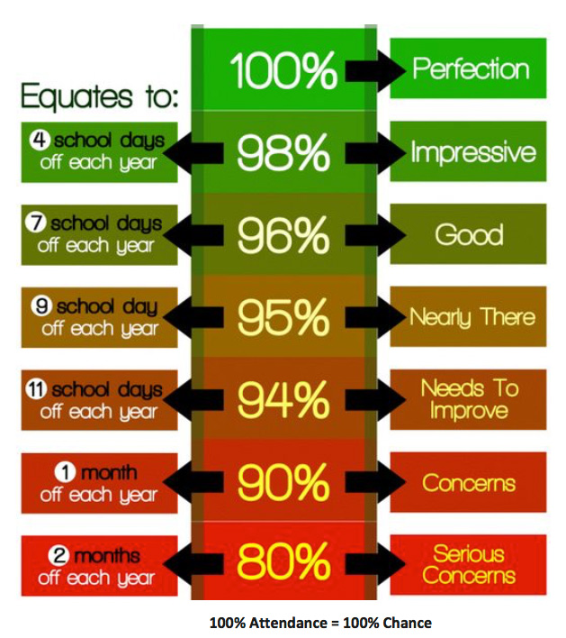
Good attendance
Every school day counts towards YOUR FUTURE...
Days off school add up to lost learning. In total, there are 175 non-school days a year.
This gives families the opportunity to:
Spend time together
Go on family visits
Attend routine appointments
Go on holiday
Go shopping
Go for days out

Slide 5
Did you Know?
95% attendance equals 10 days absence, 2 weeks off a year and 49 lessons missed
89% attendance equals 20 days absence, 4 weeks off and 98 lessons missed
85% attendance equals 29 days absence, 6 weeks off and 147 lessons missed

Slide 6
THERE IS A DIFFERENCE BETWEEN BEING UNWELL AND BEING SICK
You are sick if you have:
You are unwell if you have:
Flu
Chicken pox
A disease others can catch
Vomiting and Diarrhoea
You should NOT come to school
Cold
Headache
Stomach ache
Period pains
You should still come to school

Slide 7



Your responsibility
Your Form Tutors and Year Team will check in weekly with you and monitor your Attendance – this will mean that if your Attendance falls below 92% then a meeting will be held with you, your family and the Attendance Team.
100%
95- 99%
94.9- 90%
Below 90%

Slide 8
Graduated response & support in school
If we are concerned…
Your Head or Asst Head of Year will discuss with you
Parents/carers will be invited into school
You may get invited to a meeting with Ms Lawrence
You may get a home visit from the Attendance Team
If we are very concerned no improvement…
You may get asked to go the LEA panel
Your family will get a fine or be prosecuted

Slide 9
Attendance codes
/ present morning
\ present afternoon
AUTHORISED ABSENCES:
M = medical appointment
C = authorised absence – at the headteachers discretion

Slide 10
Attendance codes
Unauthorised Absences
U late after register closed
O unauthorised absence
G code unauthorised holiday - No more H code holiday code
10 or more unauthorised absences = a fine

Slide 11
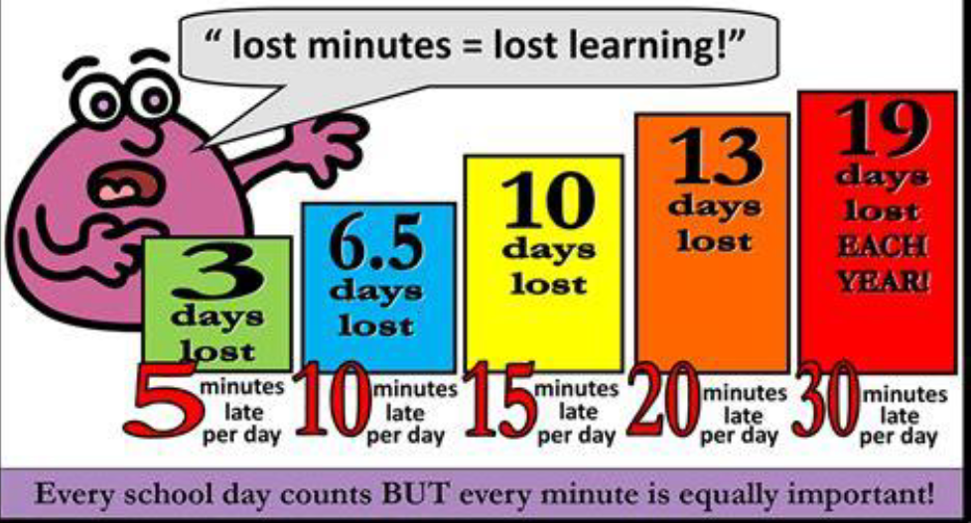
Punctuality

Slide 12
Lates after register closed
If you arrive at school after the registers close then you will get a
U code
which counts as an Unauthorised absence
Remember: 10 or more Unauthorised absences will mean a fine

Slide 13
Register marks
If you are absent your family MUST report on the Arbor App.
If an absence is not reported then a text will be sent and/or a Home Visit may be made
Any student who is absent from school and who’s attendance is 92% or below will receive a call from the Attendance Team during the morning that they are absent
Medical evidence is required for any appointments during the school day and this evidence can be uploaded in Arbor when the absence is reported

Slide 14
Holidays in term time
There are 190 school days per year!
175 days holiday per year!
ALL requests for holidays in term time WILL BE REFUSED and will result in your family receiving a fine

Slide 15
Holidays in term time
Under current regulations, Headteachers MAY NOT grant leave of absence during term-time unless there are exceptional circumstances.
The Department for Education (DfE) does not consider a need or a desire for a holiday or other absence for the purpose of leisure and recreation to be an exceptional circumstance.

Slide 16
Appointments
Please try to ensure that, where possible, appointments for the GP, Dentist and Orthodontist are booked after 9.30am. This is to ensure that you attend school first and get your AM Registration mark.
Afternoon appointments:
Please try to ensure that appointments are made at an appropriate time to enable you to get your PM Attendance at the start of Period 4 –
There will be times when this will not be possible and we understand this but we want to achieve great Attendance this year
and EVERY MARK MATTERS!

Slide 17

Rewards
Range Ready points which can be used for school trips, to buy rewards of your choice
Week 2 Friday’s Cookies delivered during Form to the tutor group in each year with most improved attendance
Y11 Prom attendance
Raffle for vouchers at the end of year for all who hit our school target of 95% and 100%

Slide 18



Attendance matters
We monitor attendance every lesson, every day, every week
‘Make sure yours is as good as it can be’

