Slide 1

RANGE HIGH SCHOOL
Attendance 2024

Slide 2
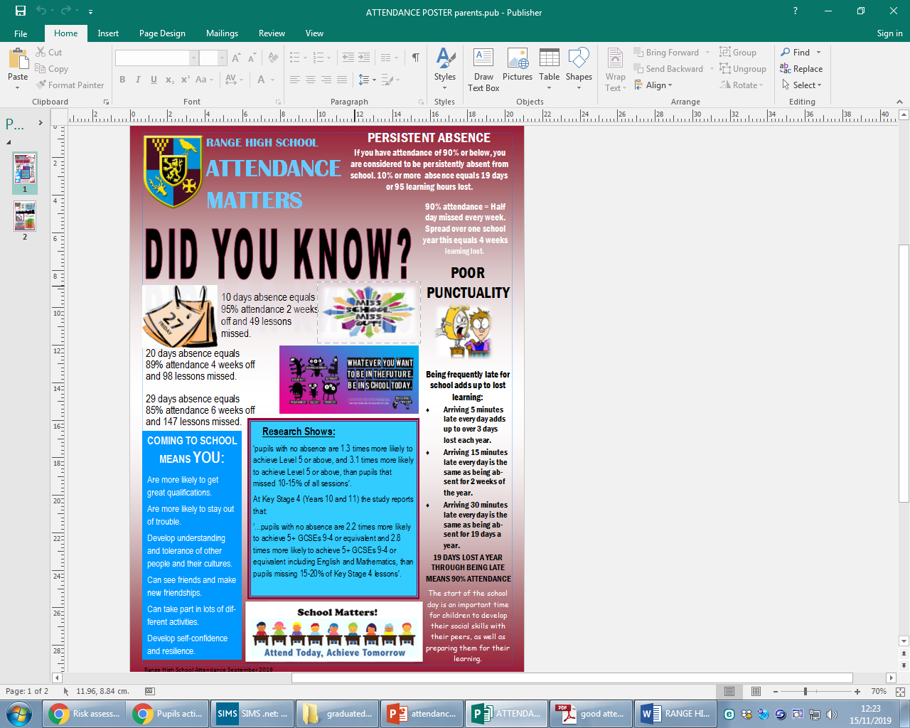

Slide 3




If you are worried about school, tell someone what’s wrong so you can get the help and support you need. There are staff in school who can help you build your confidence to come to school and help tackle any concerns.
Please speak to your Head of Year, Form Tutor, Learning Mentors or Mrs Dillon (ld@range.sefton.sch.uk).
Contact: Mrs L. Dillon
Pupil Support Manager
Range High School
Stapleton Road,
Formby L37 2YN
Tel: 01704 879315 Ext: 267
Mobile: 07496 380492
Email: ld@range.sefton.sch.uk
Our Attendance Target is 95%
COMING TO SCHOOL MEANS YOU:
Are more likely to get great qualifications.
Are more likely to stay out of trouble.
Develop understanding and tolerance of other people and their cultures.
Can see friends and make new friendships.
Can take part in lots of different activities.
Develop self-confidence and resilience.
IT IS THE LAW! PARENTS AND CARERS CAN BE FINED AND EVEN SENT TO PRISON IF CHILDREN DO NOT ATTEND SCHOOL.

Slide 4
Good attendance
Achieve the best results and GCSE grades you can
Easier settling in school and ability to make and keep friendships.
Keep up to date with work, high levels of motivation, increases enjoyment of learning
Increase confidence in school
Not missing out on the social life of school and extra curricular opportunities and experiences
If you are below 90% you are considered to be persistently absent

Slide 5


Slide 6
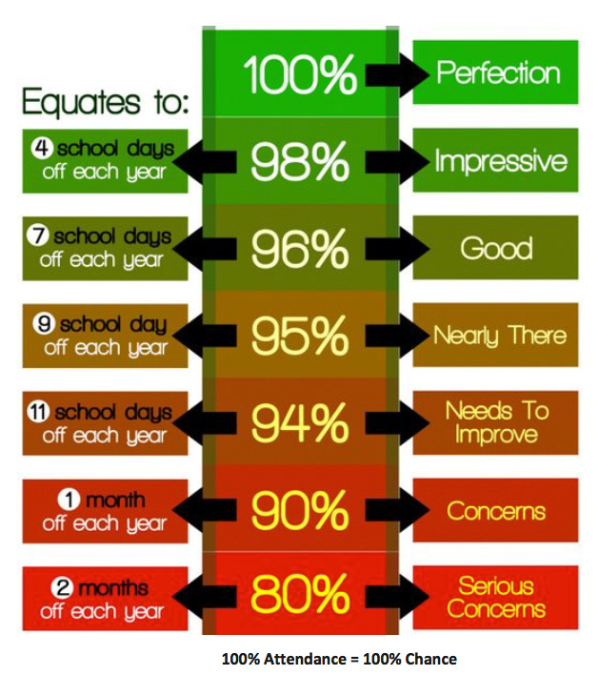
Good attendance
Every school day counts towards YOUR FUTURE...
Days off school add up to lost learning. In total, there are 175 non-school days a year.
This gives families the opportunity to:
Spend time together
Go on family visits
Attend routine appointments
Go on holiday
Go shopping
Go for days out

Slide 7
Did you Know?
95% attendance equals 10 days absence,2 weeks off a year and 49 lessons missed
89% attendance equals 20 days absence, 4 weeks off and 98 lessons missed
85% attendance equals 29 days absence, 6 weeks off and 147 lessons missed

Slide 8
THERE’S A DIFFERENCE BETWEEN BEING UNWELL AND BEING SICK
You are sick if you have
You are unwell if you have
Flu
Chicken pox
A disease other can catch
Are being sick
You should NOT come to school
Cold
Headache
Stomach ache
Period pains
You should still come to school

Slide 9



Your responsibility
You and your family have access to your attendance in class charts
100%
95- 99%
94.9- 90%
Below 90%

Slide 10
Graduated response & support in school
Your form tutor will remind you to look at your attendance regularly on class charts
All students will receive a letter each half term
If we are concerned
Your head or Asst head of year will discuss with you
Parents/carers will be invited into school
You may get invited to a meeting with Clare Colton
You may get a home visit
If we are very concerned no improvement
You may get asked to go the the LEA panel
Your family may get a fine or be prosecuted

Slide 11

Graduated response & support in school
Attendance between 100% and 95% | Well done . Keep up your good attendance
Attendance between 95% and 90% | We are registering our concern and letting you know that we will be monitoring your son or daughter’s attendance
Attendance below 90% above 80% | Your Asst. Head of Year will continue to monitor your son or daughters attendance which may include some or all, of the following Targeted 1-2-1 work with some students Parent/carer invitation to school meeting Discuss with attendance team possibility of implementing an Attendance Support Plan
Attendance below 80% | The attendance team will continue to monitor your son or daughter which may involve some, or all, of the following Targeted 1-2-1 work with some students Invite parents/carers and student to school attendance panel Implement an Attendance Support Plan. Referral to the Local Authority

Slide 12
Attendance codes
/ present morning
\ present afternoon
Authorised ABSENCES
M medical appointment
C authorised absence -headteachers discretion

Slide 13
Attendance codes
Unauthorised Absences
U late after register closed
O unauthorised absence
G code unauthorised holiday - No more H code holiday code
10 or more unauthorised absences a fine

Slide 14
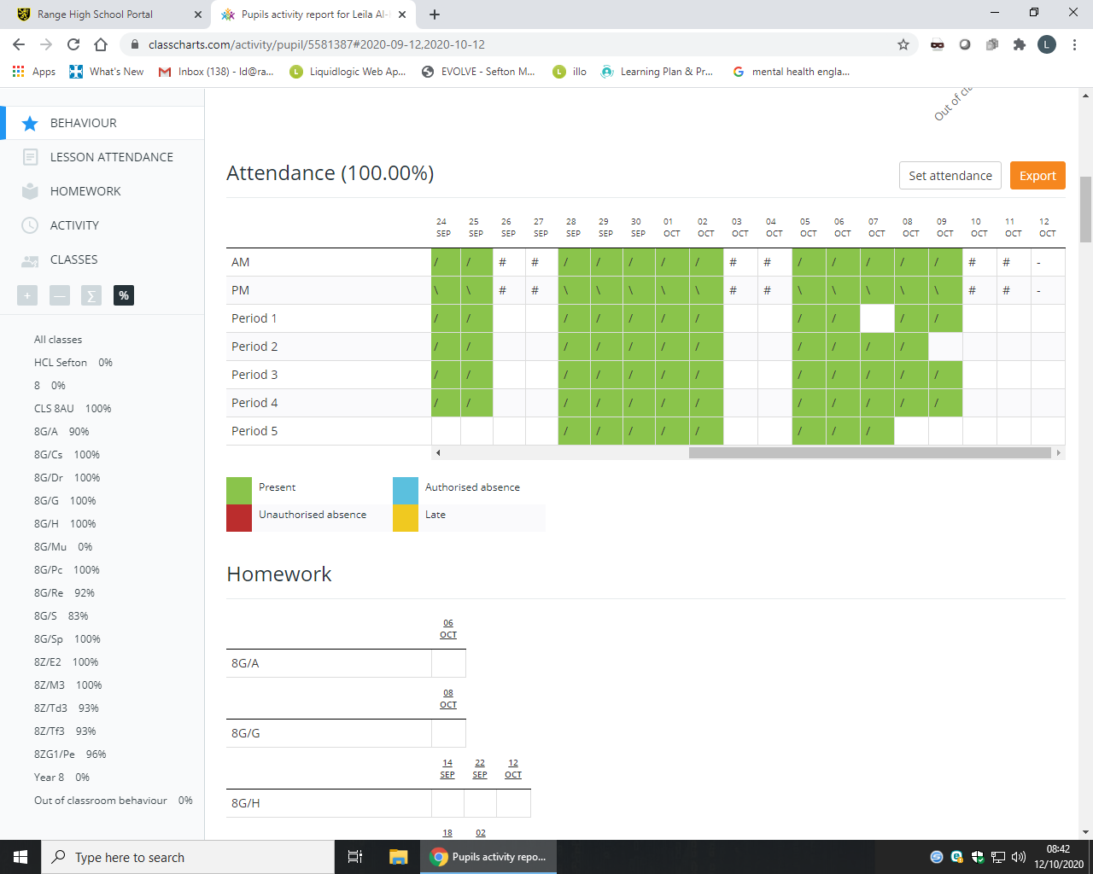

Slide 15
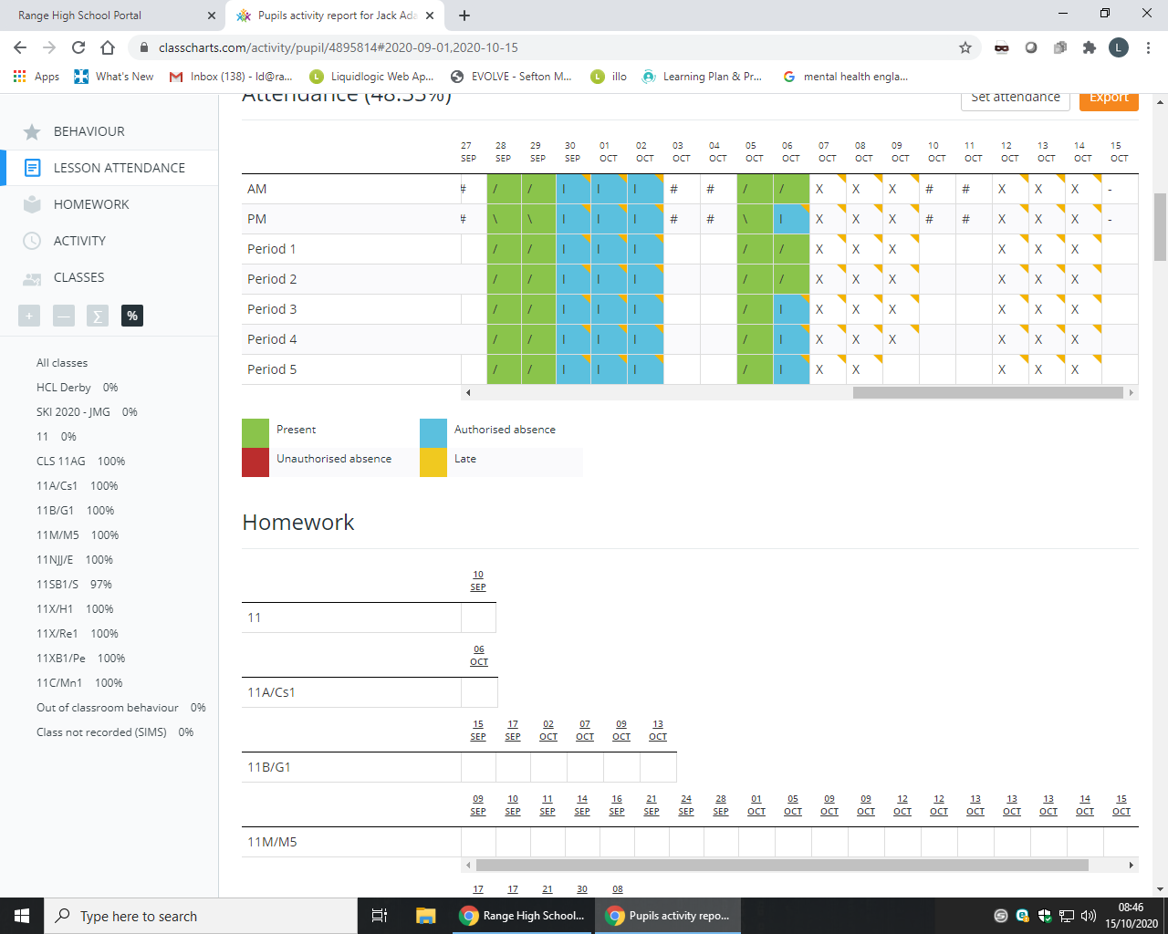

Slide 16
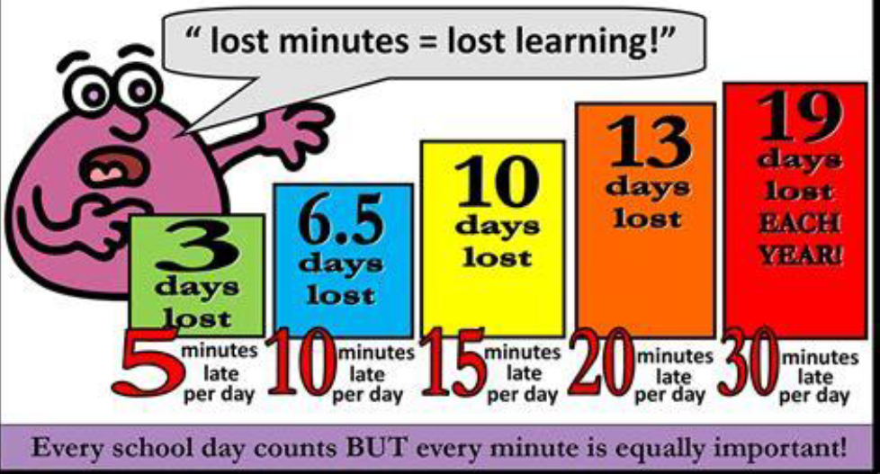
Punctuality

Slide 17
Lates after register closed
If you arrive at school after the registers close then you will get a U code which counts as an absence
91.3%
L | / | / | L | / | # | # | L | / | / | L | / | # | # | L | L | # | U | L | # | # | L | U | U | L | L | # | # | U | L | L | L
\ | \ | \ | \ | \ | # | # | \ | \ | \ | \ | \ | # | # | \ | L | # | \ | \ | # | # | \ | \ | \ | \ | \ | # | # | \ | \ | L | \
N | / | / | L | / |  |  | / | / | N | N | / |  |  | / | / |  | N | L |  |  | N | N | N | N | L |  |  | N | / | L | /
/ | L | / | / | / |  |  | / | / | / | / | / |  |  | / | / |  | / | / |  |  | / | L | L | / | / |  |  | / | / | / | /
N | / | L | / | / |  |  | / | / | / | / | / |  |  | / | / |  | / | / |  |  | / | / | / | / | L |  |  | / | / | / | /
/ | / | / | / | / |  |  | / | / | / | / | / |  |  | / | L |  | / | / |  |  | / | / | / | / | / |  |  | / | / | L | /
N | / | / | / |  |  |  | / | / | / | / | / |  |  | / | / |  | / |  |  |  | / | / | / | L | / |  |  | / | / | / | /

Slide 18
Register marks
If you are absent your family MUST report on the classcharts App.
If no call a text will be sent and or a visit may be made
Authorised/unauthorised absence
Medical evidence for any appointments

Slide 19
Holidays in term time
190 school days per year!
175 days holiday per year!
Requests for holidays in term time are refused – G code
Your family may get a fine

Slide 20

Rewards
Range Ready points trips and prizes
Range attendance lottery
Y11 prom attendance
Raffle for vouchers at the end of year for all who hit our school target of 95% and 100%

Slide 21



Attendance matters
We monitor attendance every lesson, every day, every week make sure yours is as good as it can be

