Slide 2
Welcome!
Helping your child to get the best out of
KEY STAGE 4

Slide 3
Helping your child to get the best out of Key Stage 4 and beyond
Introduction and Importance of year 10 Mrs J Plumbley – Head of Year - jp@range.sefton.sch.uk
2. Curriculum, Minimum Expected Grades, Revision and study skills -
Mr C Tees - Assistant Headteacher - cjt@range.sefton.sch.uk
3. Careers and next steps -
Mrs G. Phillips – Deputy Headteacher – gp@range.sefton.sch.uk

Slide 4
Curriculum and Minimum Expected Grades

Slide 5
Curriculum
Key Stage 3 to Key Stage 4
KS3 - Compulsory courses with few options.
KS4 - Pupils are now studying subjects they have chosen and should have a strong interest and motivation to apply themselves.

Slide 6
Curriculum
Key Stage 4
All GCSE’s are now weighted to terminal exams.
Some subjects still include an element of non exam assessment (e.g., Vocational subjects, Physical Education and Media)
Vast majority of subjects are fully examination based sat at the end of Year 11
Exception of citizenship which is sat at the end of Year 10.

Slide 7
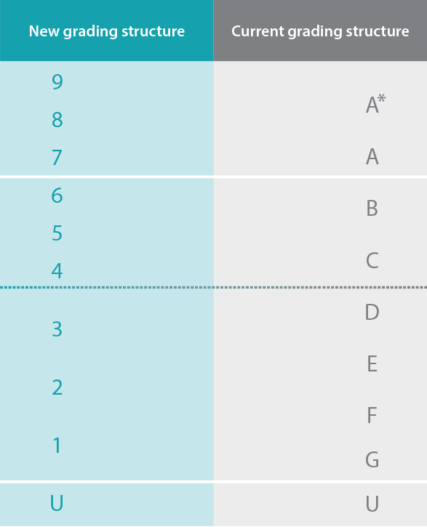
GCSE Examinations
Students will be awarded a grade from 9-1, with 9 being the highest
No tiers for GCSE English Language and Literature
Tiers (foundation and higher) for GCSE Maths, MFL and Science

Slide 8
GCSE Examinations
Students will be awarded a grade from 9-1, with 9 being the highest
No tiers for GCSE English Language and Literature
Tiers (foundation and higher) for GCSE Maths, MFL and Science

Slide 9
Implications for Y10
Internal assessments are our only diagnostic opportunity – need to take any school exams or formal assessments seriously.
These are the main measure of progress.
There is also much more material to revise than before for the final examinations.

Slide 10
Target Grades
Minimum Expected Grade - aspirational and challenging but achievable
Based upon Year 7 CATs and KS3 teacher assessment. (No SATS data this year)
Expressed in terms of a GCSE grade.
9-1 for all GCSE subjects.
Based on a national system based on the performance of previous pupils in that subject, with the same prior attainment.
Will be issued 3 times per year via email.

Slide 11
Key dates this academic year
Year 10 Interim Card WB 18th Nov 2024
Year 10 Interim Card WB 3rd March 2025
Year 10 parents evening (online) 6th March 2025
Year 10 school exams WB 28th April 2025
Card and Full written report WB 16th June 2025
THESE WILL BE SUBJECT REPORTS UNLIKE KS3

Slide 12
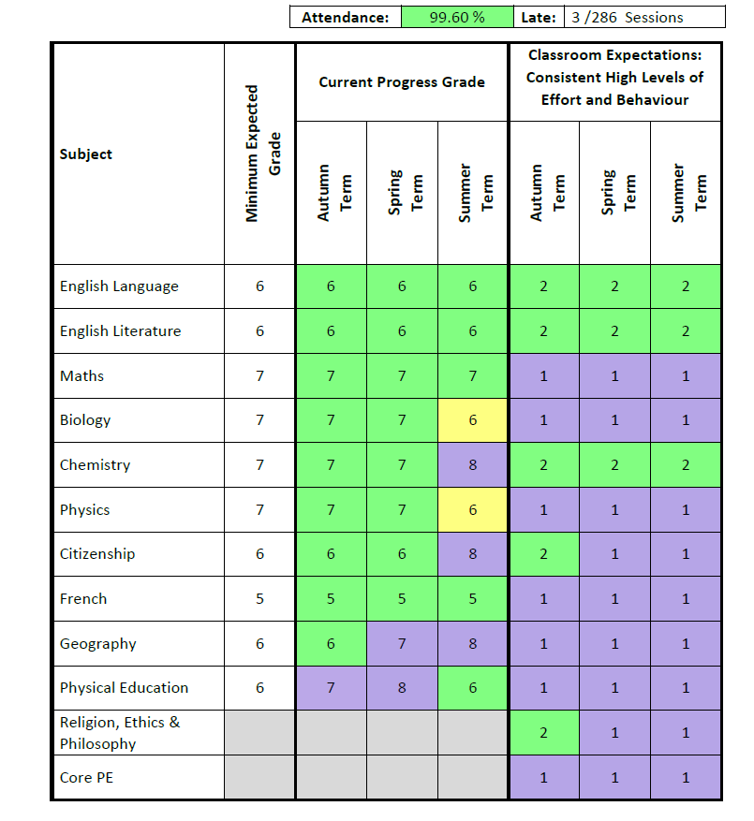
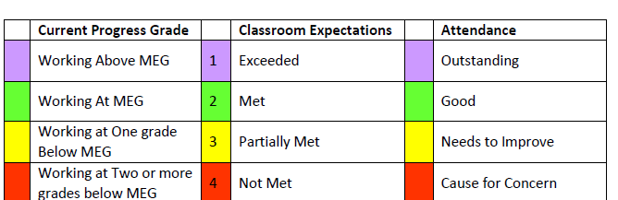
Data cards
Cards include:
Attendance and punctuality
Minimum expected grades
Currently working at grade
Number based around effort and behaviour
1
2
3
4

Slide 13
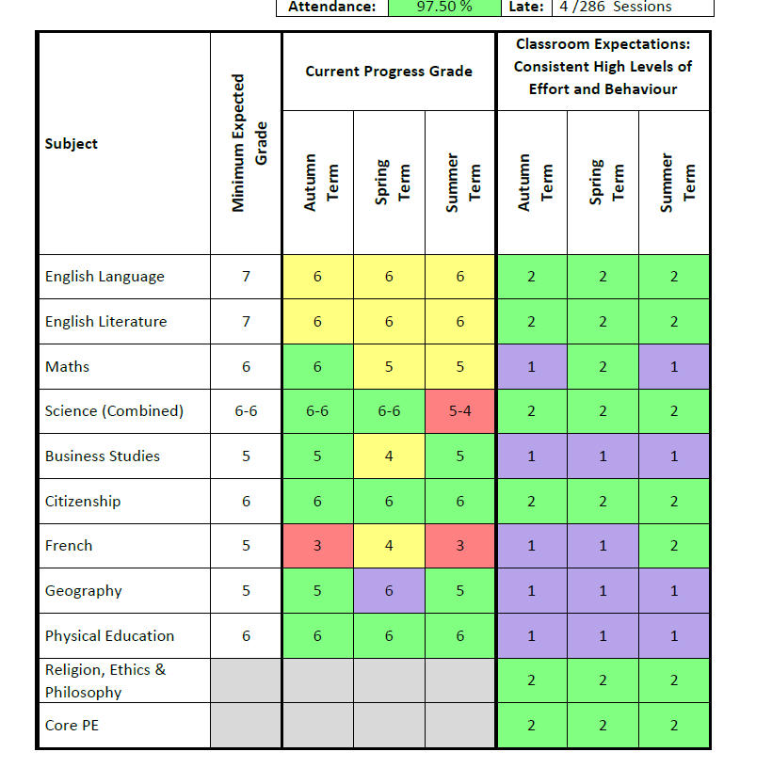
Data cards
Conversation around French and Science at home
Phone conversation or meeting with teacher/head of department

Slide 14
Data cards
Meeting with pastoral staff in school
Support plan

Slide 15
Year 10 - Citizenship GCSE
Citizenship Mock exam – 13th March 2025
GCSE Citizenship paper 1 – 8th May 2025
GCSE Citizenship paper 2 - 15th May 2025
Pupils should be recapping Theme A and B during year 10.

Slide 16
Supporting pupils through KS4

Slide 17
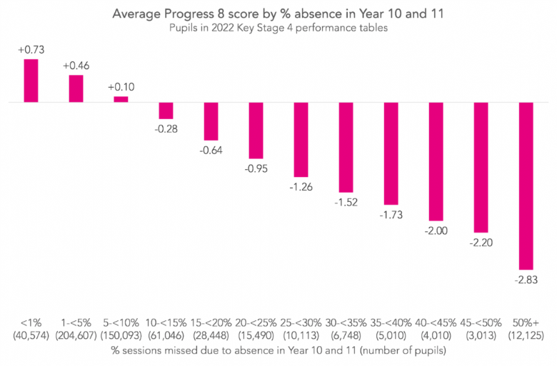
1/ How can you support your child?
Attendance
>99%
99-95%
95-90%
90-85%
85-80%

Slide 18
How can you support your child?
Attendance
At Range High School last year
  Pupils with more than 95% got an average grade of 6.3
  Pupils with between 90-95% got an average grade 5.5
  Nearly a grade of difference

Slide 19

2/ Work smart
Encourage them to:
Use a course outline/revision checklist
Use Class charts to manage homework set.
HAVE A DISTRACTION FREE PLACE TO STUDY

Slide 20

3/ Active and frequent revision
Encourage Active Revision!
Summarise.
Flash cards.
Chunk it.
Mind map
Quiz
Past papers

Slide 21
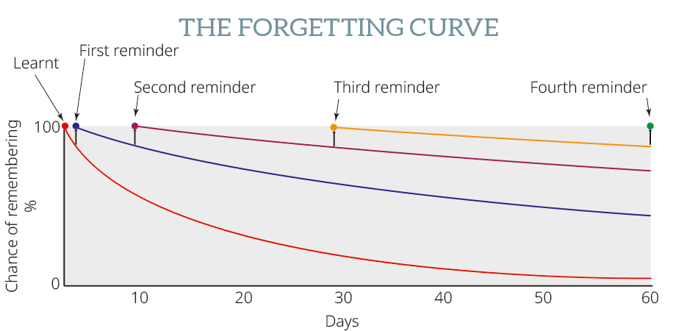
4/ Frequent reviewing is crucial
Simple wall planner or diary can make this straight forward and achievable.

Slide 22

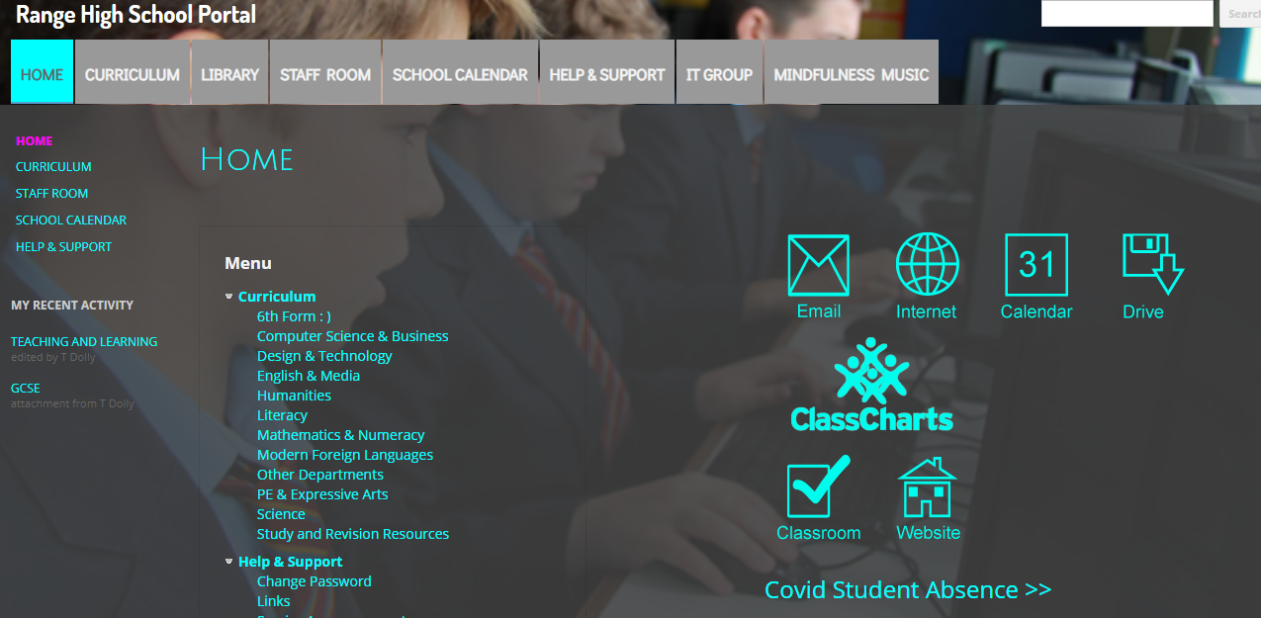
5/ Monitor how they are doing to day?
Class charts is key to helping you keep your child organised
It lets you see how they are doing on a day to day basis
itservices@range.sefton.sch.uk

Slide 23
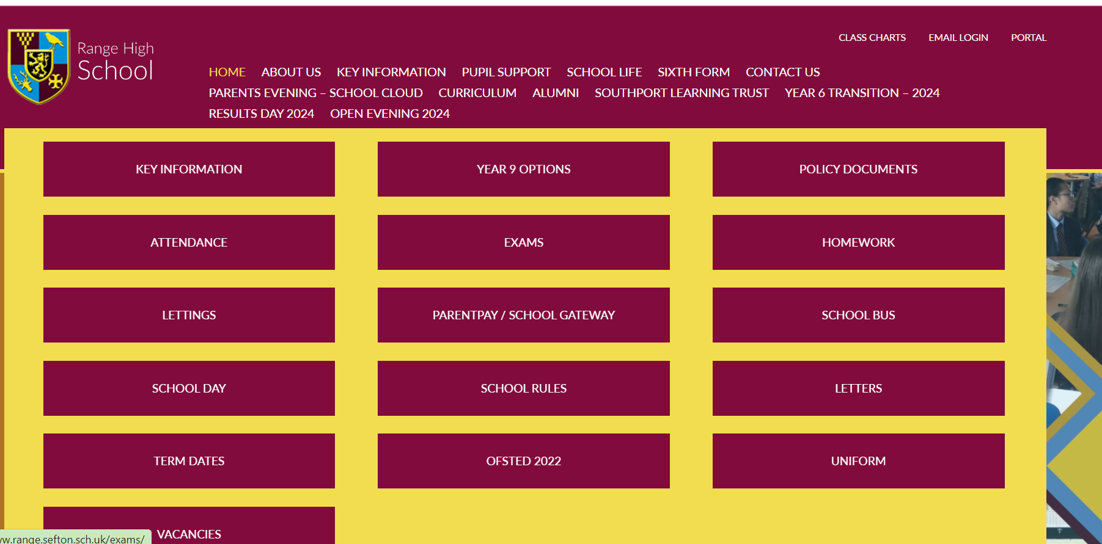
School website
Key information – Exams – GCSE
Timetables are currently up and revision lists to follow shortly.

Slide 24
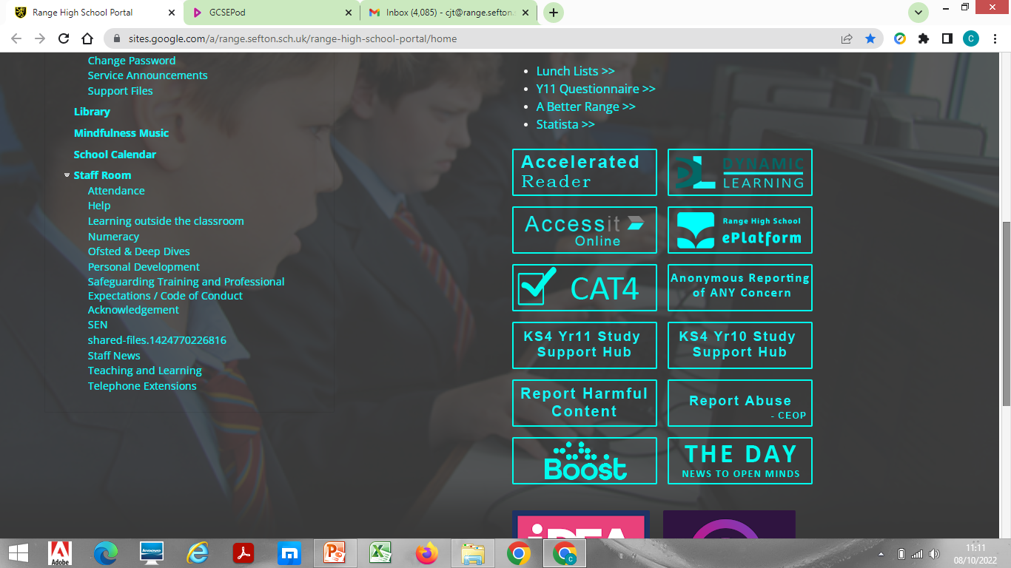
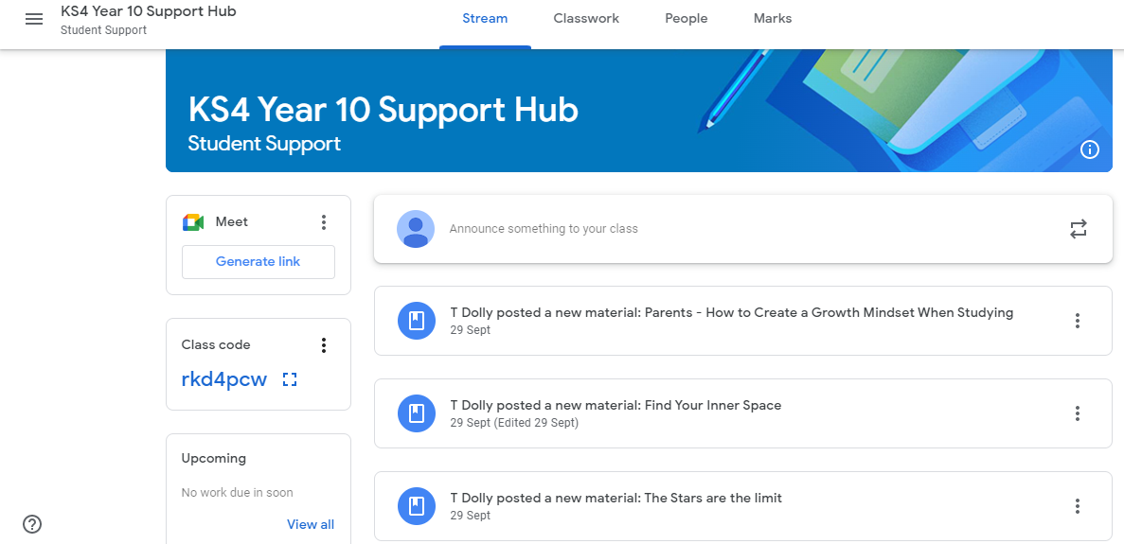
Google classroom revision hub
Study Hub

Slide 25
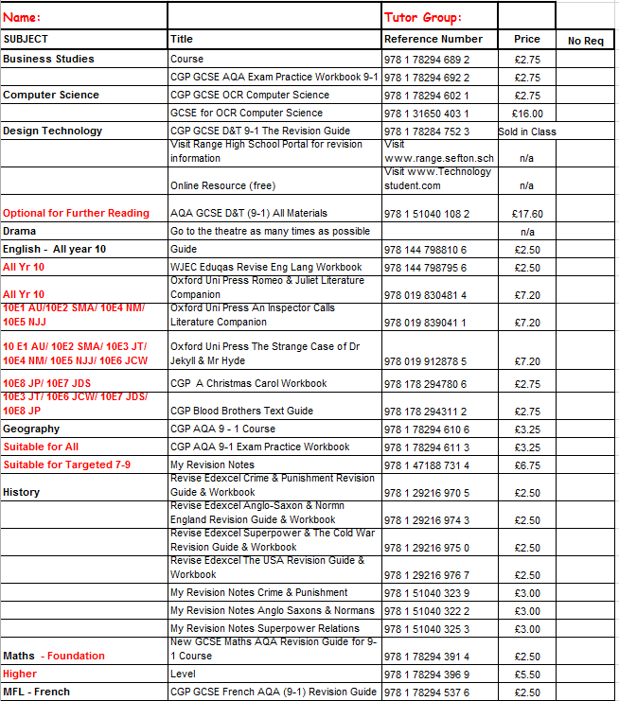
Revision guides
Exam Board approved Revision Guides
Year 10 – List finalised in the next 2 weeks and will be posted on the school website under exams.

Slide 26

Top 5 things to take away
Get them in school as much as possible.
Good communication – use the data cards – if in doubt, get in touch!
Download class charts.
Encourage distraction free study.
Encourage them get organised and to be active revisers.
Encourage and support

Slide 27
Key contacts for KS4
Form tutors
Head of Year – Mrs J Plumbley
(jp@range.sefton.sch.uk)
Assistant Head of Year – Mr K Duddridge
(kdd@range.sefton.sch.uk)
Mr C. Tees, Assistant Head teacher for Curriculum and Assessment
(cjt@range.sefton.sch.uk)
School Mentoring Team to support students at Key Stage 4

Slide 28
Preparing students for life beyond Key Stage 4

Slide 29
Careers Education Programme Years 10 & 11
Content
Equality in the workplace
Employability
Types of employment
Employee rights and responsibilities
The changing job market
Finding and using careers’ information
Options at 16
Qualification types
The impact of criminal behaviour on employability
Strands
Self-awareness
Personal development
Career exploration
Career management
Skills
Team work
Decision-making
8 one hour long careers’ education sessions throughout the year in year 10 and 11

Slide 30
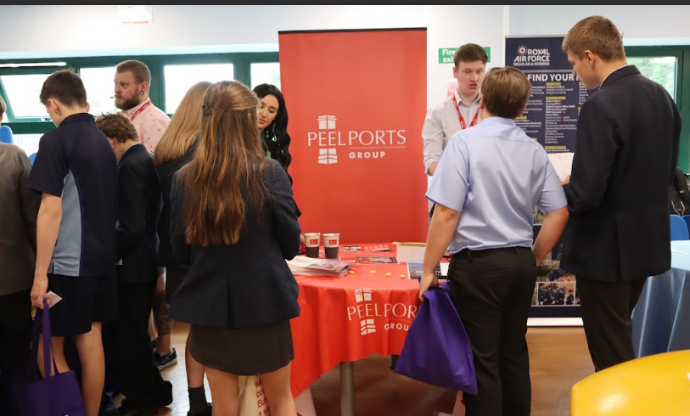
Careers Fair
We will have approx. 30 employers, apprenticeship provider and further education providers/university
Students visit different stalls about careers, apprenticeships and courses on offer in the North West.
End of June/start of July this year

Slide 31

Work experience
The first week in December of Year 11 (week after their mock examinations)
Students will complete 1 week of work experience
Students are expected to self place although we can support with this.

Slide 32
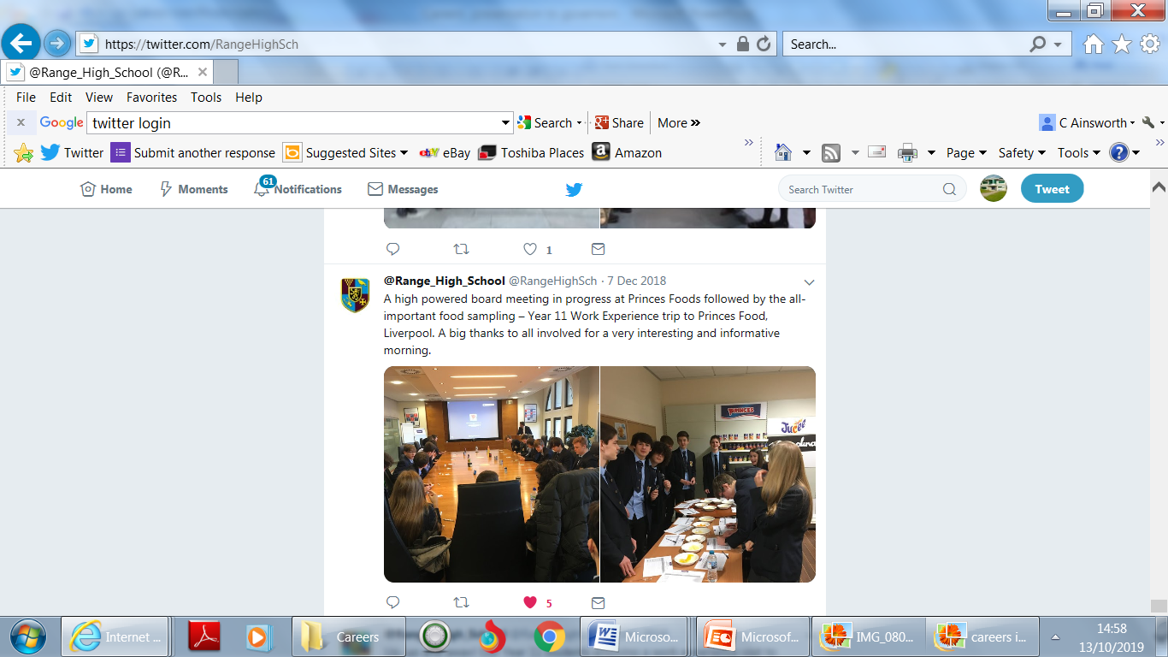
Subject specific visits
Many of our subject departments organise trips or visits by speakers to educate students about careers opportunities in their area.
For example
Trip to Jaguar Landrover
Science visit to CERN
Visiting Artists
Visits from sports physiotherapists
Pupils interested in Business sector on a visit to Princes’ Foods

Slide 33
One-to-one interviews
All KS4 students will have at least one meeting with our independent careers advisor during KS4.
They (or you) can also request another at any time. (Through Miss Gooding, rg@range.sefton.sch.uk)

Slide 34
Life after Year 11
7 year journey!
Encourage your child to use the careers opportunities and to start planning for life after Year 11
Range Sixth Form
A level (Pathway 1 – aim for grade 6+)
Vocational (Pathway 2 – aim for grade 4/5+) and
Post 16 colleges – Level 2 or Level 3 qualifications
English and Maths November resit for those students who have not achieved Grade 4

Slide 35
Thankyou for coming and any questions – please ask

