Slide 2
Welcome!
Helping your child to get the best out of
KEY STAGE 4

Slide 3
Helping your child to get the best out of Key Stage 4 and beyond
Introduction and Importance of year 10 Ms N. Wilson – Head of Year - nw@range.sefton.sch.uk
2. Curriculum, Minimum Expected Grades, Revision and study skills -
Mr C Tees - Assistant Headteacher - cjt@range.sefton.sch.uk
3. Careers and next steps -
Mrs G. Phillips – Deputy Headteacher – gp@range.sefton.sch.uk

Slide 4
Curriculum and Minimum Expected Grades

Slide 5
Curriculum
Key Stage 3 to Key Stage 4
KS3 - Compulsory courses with few options.
KS4 - Pupils are now studying subjects they have chosen and should have a strong interest and motivation to apply themselves.

Slide 6
Curriculum
Key Stage 4
All GCSE’s are now weighted to terminal exams.
Some subjects still include an element of non exam assessment (e.g., Vocational subjects, Physical Education and Media)
Vast majority of subjects are fully examination based sat at the end of Year 11
Exception of citizenship which is sat at the end of Year 10.

Slide 7
Implications for Y10
Internal assessments are our only diagnostic opportunity – need to take any school exams or formal assessments seriously.
These are the main measure of progress.
There is also much more material to revise than before for the final examinations.

Slide 8
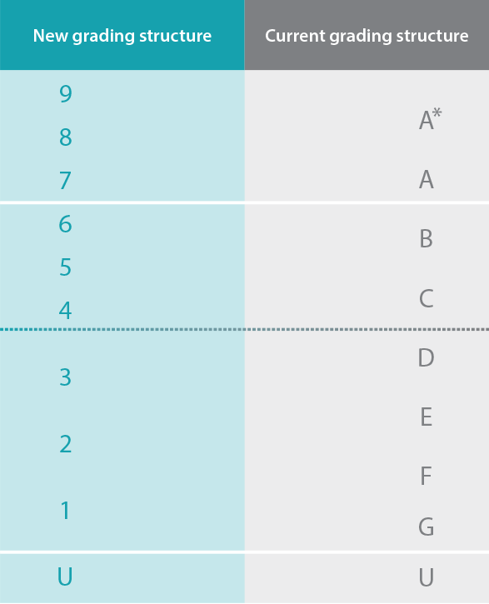
GCSE Examinations
Students will be awarded a grade from 9-1, with 9 being the highest
No tiers for GCSE English Language and Literature
Tiers (foundation and higher) for GCSE Maths, MFL and Science

Slide 9
GCSE Examinations
Students will be awarded a grade from 9-1, with 9 being the highest
No tiers for GCSE English Language and Literature
Tiers (foundation and higher) for GCSE Maths, MFL and Science

Slide 10
Target Grades
Minimum Expected Grade - aspirational and challenging but achievable
Based upon Year 7 CATs and KS3 teacher assessment. (No SATS data this year)
Expressed in terms of a GCSE grade.
9-1 for all GCSE subjects.
Based on a national system based on the performance of previous pupils in that subject, with the same prior attainment.
Will be issued after half term via the interim card.
IF YOU HAVE ISSUES – PLEASE GET IN TOUCH

Slide 11
Data cards
Cards are key for highlighting issues
Attendance and punctuality will be in bands

Slide 12
Key dates this academic year
Year 10 Interim Card WB 8th Nov 2023
Year 10 Interim Card WB 27th Feb 2023
Year 10 parents evening 9th March 2023
Year 10 school exams WB 24th April 2023
Card and Full written report WB 5th June 2023
THESE WILL BE SUBJECT REPORTS UNLIKE KS3
These are staff deadlines so you will expect the cards and reports around a week after.

Slide 13
Supporting pupils through KS4

Slide 14
Key contacts for KS4
Form tutors
Head of Year – Ms N Wilson
(nw@range.sefton.sch.uk)
Assistant Head of Year – Mr J Wilson
(jcw@range.sefton.sch.uk)
Mr C. Tees, Assistant Headteacher for Curriculum and Assessment
School Mentoring Team to support students at Key Stage 4

Slide 15
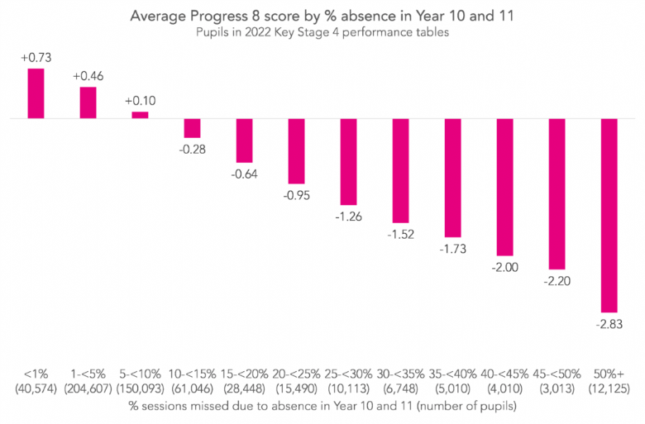
How can you support your child? Attendance
>99%
99-95%
95-90%
90-85%

Slide 16
How can you support your child? Attendance
At Range High School last year
Pupils with more than 95% got an average grade of 6.3
Pupils with between 90-95% got an average grade 5.5
Almost a full grade in difference on average

Slide 17
How can you support your child?
Get them organised!
Encourage them to:
Use a course outline
Keep school notes organised.
Review work regularly.
Use Class charts to manage homework set.
Use the revision resources provided by school.
Get books or equipment for their courses
HAVE A DISTRACTION FREE PLACE TO STUDY

Slide 18
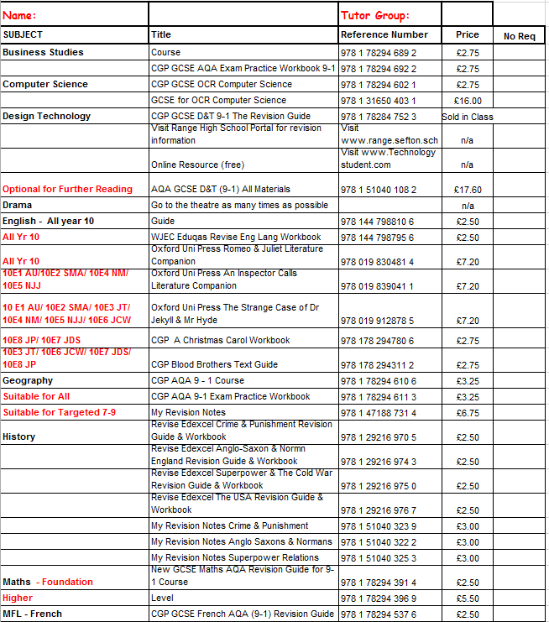
How can you support your child?
Exam Board approved Revision Guides
Year 10 – List finalised in the next 2 weeks and online order form will go out to parents.

Slide 19
How can you support your child?
Class charts is key to helping you keep your child organised
It lets you see how they are doing on a day to day basis
itservices@range.sefton.sch.uk

Slide 20
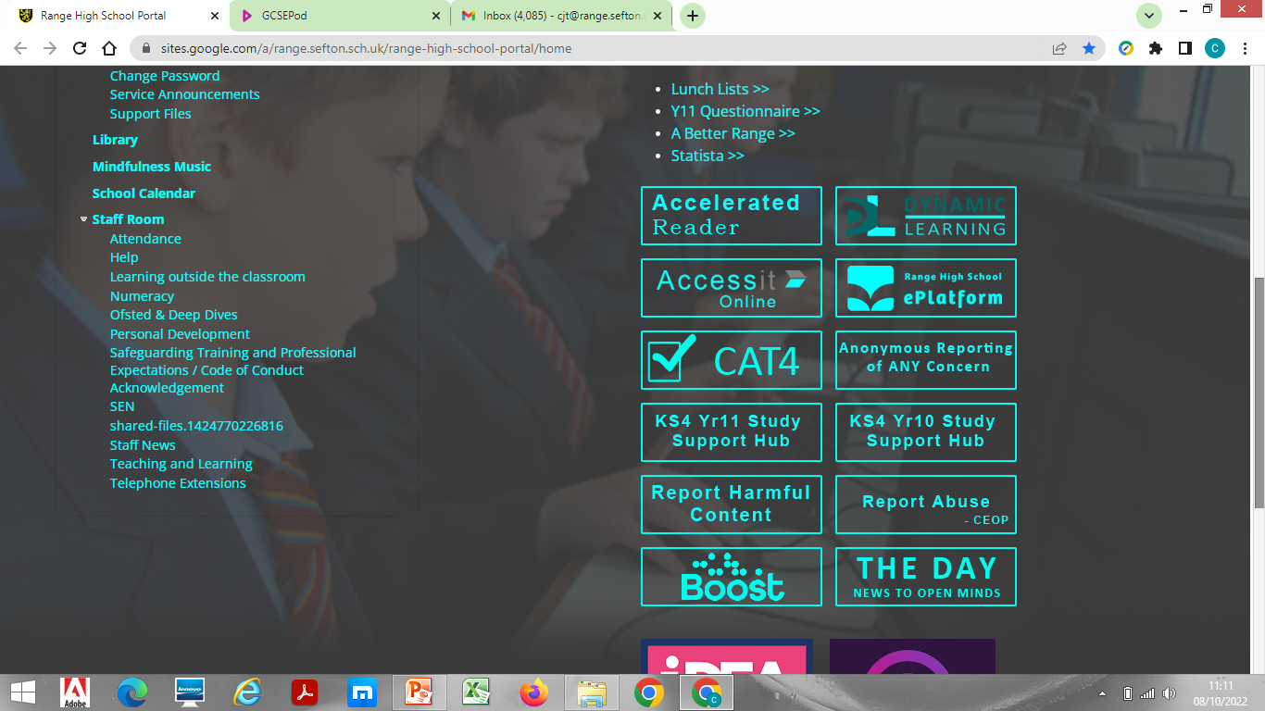
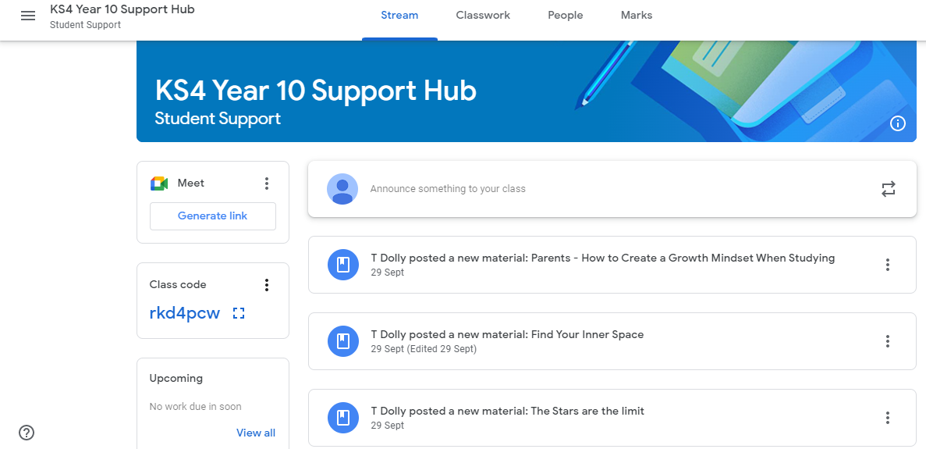
Google classroom revision hub
Study Support

Slide 21
Study Support
Lots of examples of active study skills information on the Year 10 Support Hub

Slide 22
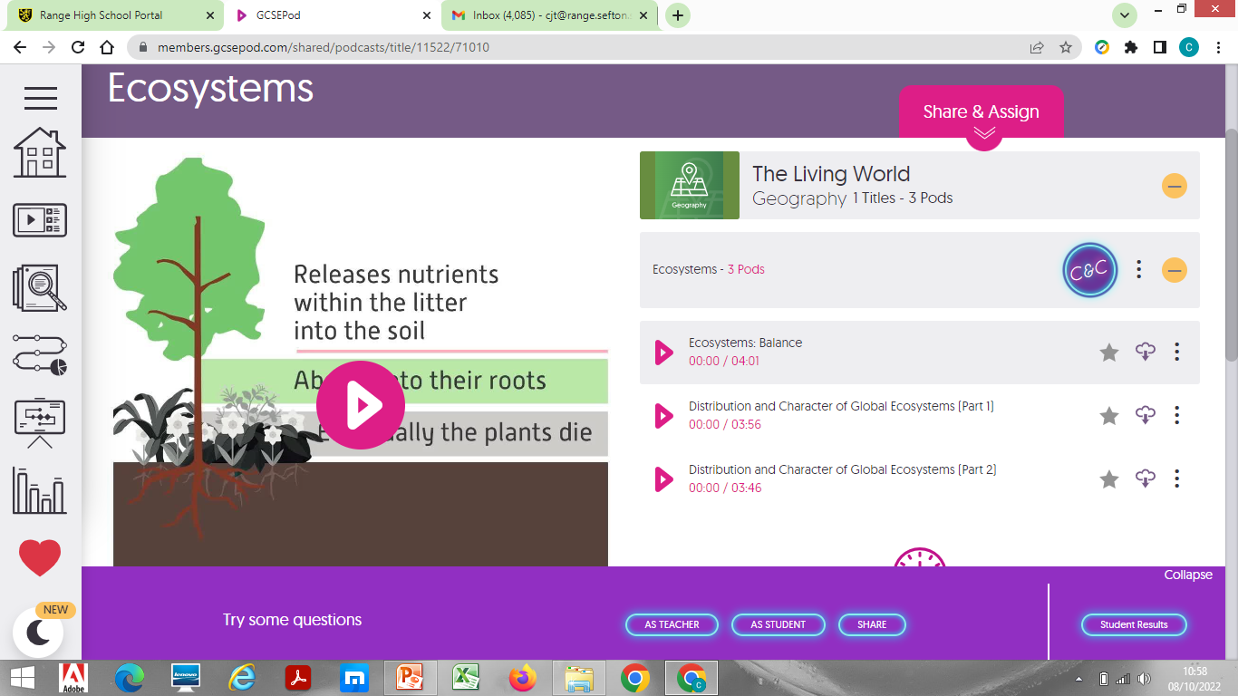
GCSE POD
Study Support

Slide 23
Study
skills

Slide 25
Study skills
Encourage Active Revision!
Summarise.
Bullet point.
Chunk it.
Mind map
Quiz
Past papers

Slide 26
Frequent reviewing is crucial

Slide 27
Top 5 things to take away
Communicate with school – if in doubt, get in touch.
Download class charts
Provide a distraction free place for your child to study
Help them get organised
Encourage and support

Slide 28
Beyond Key Stage 4

Slide 29
Careers Education Programme Years 10 & 11
Content
Equality in the workplace
Employability
Types of employment
Employee rights and responsibilities
The changing job market
Finding and using careers’ information
Options at 16
Qualification types
The impact of criminal behaviour on employability
Strands
Self-awareness
Personal development
Career exploration
Career management
Skills
Team work
Decision-making
8 one hour long careers’ education sessions throughout the year in year 10 and 11

Slide 30
Meet the Professionals / Careers Fair
We will have approx. 30 employers, apprenticeship provider and further education providers/university
Students visit different stalls about careers, apprenticeships and courses on offer in the NW.
End of June/start of July this year

Slide 31
Work experience
The first week in December (week after their mock examinations)
Students will complete 1 week of work experience
Students are expected to self place although we can support with this.

Slide 32
Subject specific visits
Many of our subject departments organise trips or visits by speakers to educate students about careers opportunities in their area.
For example
Trip to Jaguar Landrover
Science visit to CERN
Visiting Artists
Visits from sports physiotherapists
Pupils interested in Business sector on a visit to Princes’ Foods

Slide 33
One-to-one interviews
All KS4 students will have at least one meeting with our independent careers advisor during KS4.
They (or you) can also request another at any time. (Through Miss Gooding, rg@range.sefton.sch.uk)

Slide 34
Thankyou for coming

