Slide 1

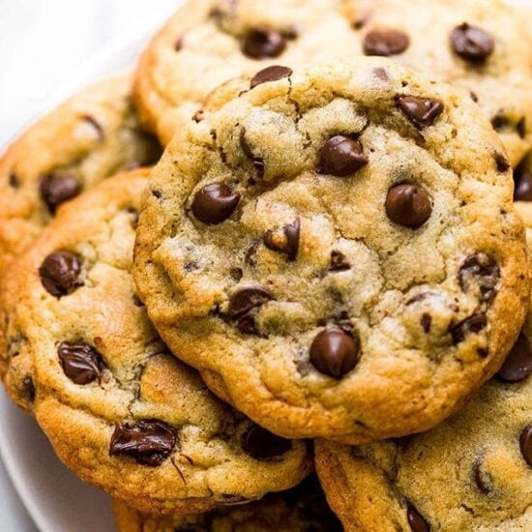

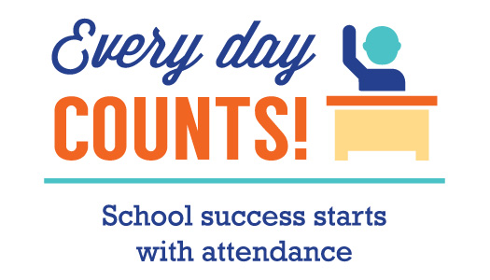
Most improved tutor group attendance
Help your tutor group win cookies every fortnight. Make sure you’re in school
Most improved tutor group every WEEK 1 FRIDAY will win cookies for tutor time

