Slide 1
Title slide
Student Finance
PENNY DUNNE

Slide 2
Aims
STUDENT LOANS COMPANY
TUITION FEE SUPPORT
MAINTENANCE SUPPORT
REPAYING STUDENT LOANS
ADDITIONAL SUPPORT
APPYLING FOR STUDENT FINANCE
Expand your Opportunities with Edge Hill

Slide 3
Student Loans Company
Expand your Opportunities with Edge Hill

Slide 4
Student Loans Company
Who are they?
Student Loans Company are run and owned by Government
Not a private company, lender or a bank
Each country in the UK has their own version depending on where a student lives – Student Finance England (SFE)
Students apply for two loans from them:
Tuition Fee Loan
Maintenance Loan
Expand your Opportunities with Edge Hill

Slide 5
Tuition fees
Expand your Opportunities with Edge Hill

Slide 6
What are Tuition fees?
Max £9,250 per year
Eligibility:
UK citizen for 3 years
Studying in UK for 3 years
Studying in UK
First Degree
(There are some exceptions)
Repayable
Paid directly to your university
No up-front fees
Expand your Opportunities with Edge Hill

Slide 7
What does this cover?
Lectures, seminars and tutorials
Compulsory course field trips
Professional Body Examination Fees
University support services
Access to university library
Access to computer facilities
Administrative costs
Membership of a students’ union
Expand your Opportunities with Edge Hill

Slide 8
Maintenance Loan
Expand your Opportunities with Edge Hill

Slide 9
Maintenance Loan
Covers cost of day to day living
Part non-means tested, part means-tested
Means tested linked to household income
Repayable
Transferred to your account in three termly instalments – September, January, April
Expand your Opportunities with Edge Hill

Slide 10
Maintenance Loan
Student’s living arrangement | Maximum amount from Student Finance England 2022/23*
Parental Home | £8,171
Elsewhere | £9,706
London | £12,667
Year abroad (as part of UK course) | £11,116
What you can receive as a student depends on where you live and household income…
*amounts will be lower for final year students
Expand your Opportunities with Edge Hill

Slide 11
Household Income
Household income | Home 2022/23* | Elsewhere 2022/23* | London 2022/23*
£25,000 & under | £8,171 | £9,706 | £12,667
£30,000 | £7,484 | £9,012 | £11,961
£35,000 | £6,796 | £8,318 | £11,255
£40,000 | £6,108 | £7,623 | £10,549
£42,875 | £5,713 | £7,224 | £10,143
£45,000 | £5,420 | £6,929 | £9,843
£50,000 | £4,733 | £6,234 | £9,136
£55,000 | £4,045 | £5,540 | £8,430
£60,000 | £3,597 | £4,524 | £7,724
£65,000 | £3,597 | £4,524 | £7,018
Based on gross taxable household income
Based on income of household where the student predominantly resides
Step parents/partners’ incomes are included in household income
Assessed based on prior financial year
If income has dropped by more than 15% you can request a current year assessment
*amounts will be lower for final year students
Expand your Opportunities with Edge Hill

Slide 12
Part-time work
Gives you a chance to earn extra money
And to help with your budget!
Meet new people and make an impression
Can add to your transferable skills to enhance future employment
Advantage platform brings together all extra-curricular activities available on campus, including jobs
Expand your Opportunities with Edge Hill

Slide 13
Repaying your Student loan
Expand your Opportunities with Edge Hill

Slide 14
How repayment works
The two loans are combined together
Start to repay once:
You’ve graduated
You’re earning above £27,295* (*Changing to £25,000 for 2023)
You will repay 9% of your income above the repayment threshold of £27,295/£25,000*
*subject to change
Expand your Opportunities with Edge Hill

Slide 15
Repayment Thresholds
Yearly income before tax | Monthly income before tax | Monthly repayment (Approx.)*
£25,000 | £2,083 | £0
£30,000 | £2,500 | £37.50
£35,000 | £2,916 | £75
£40,000 | £3,333 | £112.50
£45,000 | £3,750 | £150
£50,000 | £4,166 | £187.50
£60,000 | £5,000 | £262.50
If you move or work overseas, repayments will still be taken
After 40 years* of repaying, whatever’s left over is written off completely
You will only ever repay from when you’re earning above £25,000*
*subject to change
Expand your Opportunities with Edge Hill

Slide 16
Interest Rates
Whilst studying and until the April after leaving the course – RPI + 3% (9%)* (Changing to RPI only for 2023)
From April after leaving the course:
Salary | Interest Charged*
£25,000 or less | RPI (currently 9%)
£25,000 to £49,130 | RPI
Over £49,130 | RPI
Early repayment is not particularly advised
Repayments taken directly from salary
Talk to your religious leader for advice where required
*subject to change
Expand your Opportunities with Edge Hill

Slide 17
Repayment Scenario
Scenario 1:
Student loan £20,000. Your earnings £30,000. Your annual repayment is £450
Scenario 2:
Student loan £50,000. Your earnings £30,000. Your annual repayment is £450
Students should see this as a 9% higher tax rate
‘Student loans’ is a misnomer – elsewhere similar schemes are called a ‘graduate contribution’ system. We should call is this too.
Martin Lewis, Money Saving Expert
Expand your Opportunities with Edge Hill

Slide 18
Applying for Student Finance
Expand your Opportunities with Edge Hill

Slide 19
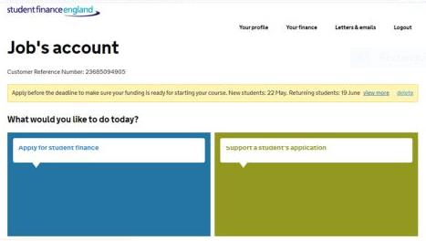
Application
Online application
Applications open in March
Apply as early as possible
Closing date end of May (to guarantee payment in time for course start date)
You will need to provide your National Insurance Number
Expand your Opportunities with Edge Hill

Slide 20
Role of the supporter
A parent/carer/partner who provides some details to support an application
They will be sent an e-mail with log-in details after the student starts the application
Supporter needs to fill in income details - may need to provide evidence
Gross financial income for prior tax year (unless this has dropped by 15% or more)
Don’t immediately need any evidence but good to save it in case!
Will be asked for the number of dependants who are both wholly, and partially, financially dependent on you (the supporter)
Expand your Opportunities with Edge Hill

Slide 21
Useful documents
Students should have the following to hand:
Passport – if available, but not essential
University and course details
Bank account details
National Insurance number
Supporters should have the following to hand:
National Insurance number
Household income information (based on prior tax year)
Expand your Opportunities with Edge Hill

Slide 22
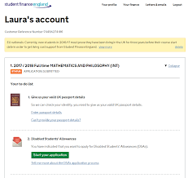
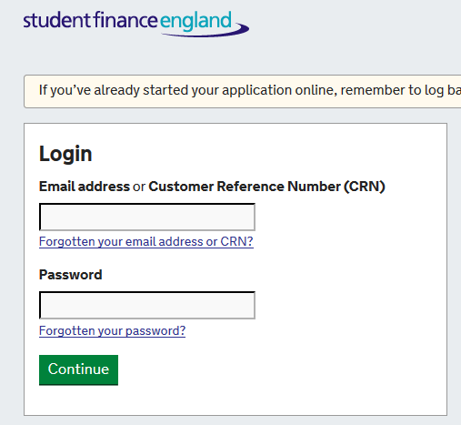
Submitting your application
Once completed, a page will come up
Pay attention to this as it will show you what to do next (if anything)
You maybe required to upload or send documents to Student Finance
Log back into your account to track your application
Expand your Opportunities with Edge Hill

Slide 23
Key Messages
Apply early – can take up to six weeks
Previous study does not include your GCSE/A-Level/BTEC qualifications
Don’t need a confirmed place to apply
Agree to share information
Only receive money when enrolled
A late application can result in late payment
Re-apply every subsequent year
Submit Online Terms and Conditions (OTC) via the online account with an e-signature
Expand your Opportunities with Edge Hill

Slide 24
Overview
Financial support available
Tuition fee loan | Maintenance loan
Paid direct to your University | Paid in instalments direct to you
Up to £9,250 | Household situation
Repayable | Repayable
Both loans are optional
Only start to make repayments once:
you’ve left university
your income is over £25,000 a year*
If you earn below £25,000 repayments stop*
*subject to change
Expand your Opportunities with Edge Hill

Slide 25
General Information:
www.thestudentroom.co.uk/student-finance
www.ucas.com/sfe
www.moneysavingexpert.com
Student Finance:
www.gov.uk/student-finance
EU and International Students:
www.ukcisa.org.uk
www.study-uk.britishcouncil.org/moving-uk/eu-students
NHS Bursary & Learning Support Fund:
www.nhsbsa.nhs.uk/nhs-bursary-students
Student Budget Calculator:
www.which.co.uk/money/university-and-student-finance/student-budget-calculator
Student Finance England:
0300 100 0607 or @SF_England
Expand your Opportunities with Edge Hill

Slide 27
Closing slide
Expand your
Opportunities
WITH EDGE HILL
EHU.AC.UK/DISCOVER

