Slide 1
Tips for managing anxiety with Covid-19
(Corona virus)
Self-care
Introduce activities/times to help you relax and reduce any anxiety/worry. This might be a home workout, having a bath, cooking, cleaning, organising areas of your house, watching TV, DIY projects, anything that you enjoy and find pleasure in!
Routine
We are all used to routine, be that going to work or school or getting up at particular times. If you are now working from home, in self-isolation or home-schooling children, try and create a routine or plan each day as it comes. Allow yourself rest breaks, keep a lunch break, and be more flexible in putting in activities like watching the tv and doing household activities.
Social media
For some social media is highly important in keeping connected and in touch with family/friends/vulnerable people. But it can also be a source escalating your worry. Consider whether it might be better to reduce social media use, perhaps by time (10 minutes at a time) or only at certain times of the day (when taking work/school breaks).
This is not an exhaustive list but just some suggestions that may be helpful!
Please keep up to date with government guidance and take care of yourselves.

Slide 2
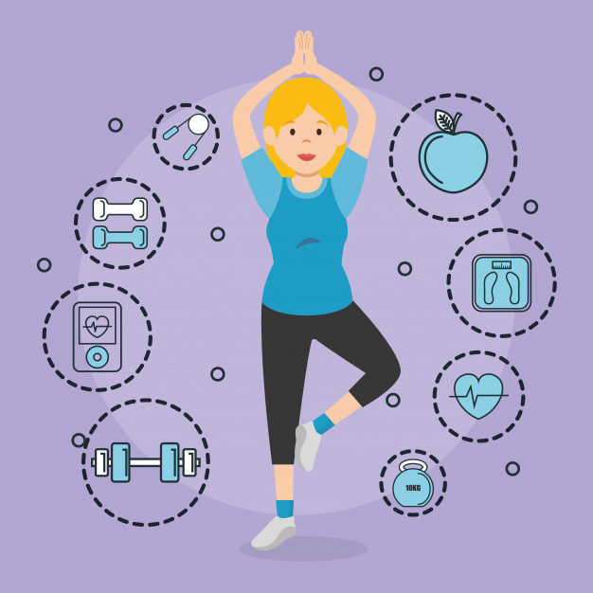
Tips for managing anxiety with Covid-19
(Corona virus)
Time and space
Give yourself a space to worry: It is natural and normal to worry, particularly in times of crisis, however this can get the better of us. You could consider planning small time frames where you allow yourself to worry, or use a form of expression (e.g. writing, art or talking) to let out these thoughts. Giving yourself a space to allow this can help contain worry so that it does not feel all consuming all of the time.
Exercise
Exercise helps to manage anxiety and releases some of the anxious energy in the body. YouTube has loads of workouts you can do at home, try the body coach, search for home workouts, home yoga or any home alternative to the exercise you enjoy! Follow the guidance from the government.
Support
If you have existing mental health problems reach out to your support network and professional if you have one. If these feelings are new also reach out to people that you find supportive. Many people are feeling the same way and it will help you to feel less alone. You can share your own tips for staying calm and managing the situation. If you don’t feel that you have support you can text SHOUT for free from most UK mobiles, check out their website “giveusashout.org” for more information.
This is not an exhaustive list but just some suggestions that may be helpful!
Please keep up to date with government guidance and take care of yourselves.

