Slide 1
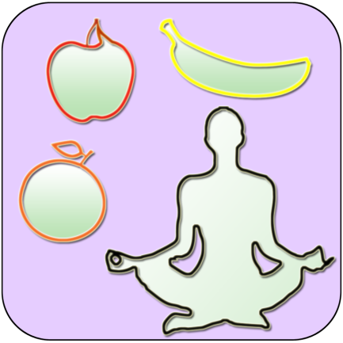
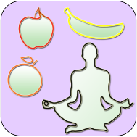
Looking after yourself at home
If you've been asked to stay at home and avoid other people, it might feel more difficult than usual to take care of your mental health and wellbeing. You might find that you need to come up with a plan to help you to feel OK if you are not in school for a while. It’s also useful to know that it is completely normal to be worried and to know what you can do if you aren’t feeling OK.
There is a lot of information in these slides. Don’t panic about trying to remember it all! We are putting together a sheet of information for you to take home and we will put it all on the school website too.

Slide 2
To identify potential concerns or worries
To understand how and where to seek help if you are worried or feeling low
To think about what you can do to prevent these feelings occuring
How do we keep our minds healthy?

Slide 3
Keeping healthy at home
On your tables (or in small groups), brainstorm ideas to keep your body and mind as healthy as possible if you have to stay at home for a long period of time. (3 mins)
Take ideas from the class (2 mins)
e.g. make sure you drink lots of water
Keeping a healthy body and mind

Slide 4
Healthy body
Remember that keeping your body healthy will not only help to prevent you becoming physically ill, but it will help to support your mental health too.
Eat a healthy diet – fruit, vegetables, water – not all sugar, crisps and fizzy drinks – it will make you feel rubbish! And your body will really need vitamins and good energy.
Try to stick to a routine with eating breakfast, lunch and dinner and not snacking too much in between. If you do have snacks, try not to have too many or unhealthy ones.
Exercise – even if you have to stay home – you can go into your garden if you have one, if not how can you exercise in your home? (If your parents say it’s ok, you may be able to go for a short walk)
Sleep – when you are asleep your body rests and repairs itself and your brain takes the time to process everything that it needs to. If you get into an unhealthy sleep pattern (i.e. going to bed very late/getting up very late) your body and mind will find it very difficult to work at their best.

Slide 5
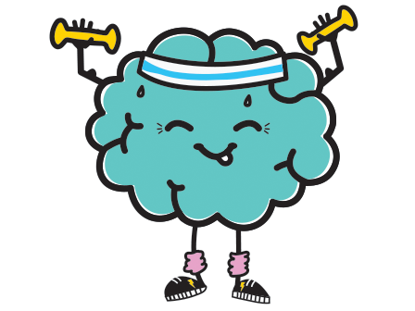
Healthy mind
Being at home for long periods can cause worry and stress. These are some ideas for you to use at home to ensure that you look after your mental health.
Keep your room clean and tidy – mess in your environment will have an effect on your mind too
Try to give yourself some space – family members can be annoying! Build time into the day (just for 30 mins or an hour) where you can be by yourself. You could listen to music, read a book or watch your favourite TV program
But… don’t isolate yourself too much! Make sure you are talking to your friends and family via phone/text etc. if you can’t see people face to face
If you can go outside to get some sunlight or fresh air then do, if not, try to open windows to get fresh air in and open curtains blind to let the light in.
Have a routine. Routines help us to feel more normal when things are weird. What kind of routine could you have at home?
Stay busy! On the following slides there will be some ideas of things that you can do to stop you from getting bored.

Slide 6
Keeping busy
Keeping busy can really help to pass the time, prevent boredom and generally make us feel better. You will have school work to do, but it won’t take up your whole day and it’s important that you do other things too.
Turn and talk (1 min) – what do you enjoy doing at home if you’re bored?
Ideas:
Read a book – if you run out of books, the Kindle app is free to download on to any smart phone and there are free books on there too! (There is also a site called Project Gutenberg with free ebooks)
Listen to an audiobook – again there are sites where these are free – StoryNory, Lit2Go, Project Gutenberg and the International Children’s Digital Library are a few.
Be creative – draw, paint, colour in, make a collage or sculpture from ‘rubbish’ in your home, sew, bake (with help)
Make your own project – think about the work you did over the summer about the women our forms are named after – could you do something similar about someone else you admire?
Watch a film or TV program and write a review/blog about it
What else did you come up with?

Slide 7
Feeling anxious or stressed?
Sometimes situations like this can make us feel anxious or stressed. Here are some ideas of things that might help.
If all of the news articles or programs are making you worry, stop watching them or reading them. You don’t need to know every update every moment. Your parents will tell you anything that you really need to know.
Try to distract yourself with some of the ideas on the previous slide or other things that you like to do.
Talk to someone that makes you smile – it might be a sibling, family member or friend. This is the perfect opportunity to give someone a call – they might be feeling the same!
Build a routine for things like washing hands so that you don’t become obsessed with it – e.g. set an alarm on your phone for every 2 hours and do it then so you won’t worry
Have a look at the next slide for some suggestions for breathing exercises to help you calm down and some apps that you can download for free to support you.

Slide 8
Staying calm
All have a go at high five breathing (this can support you with calming down if you are feeling worried or anxious)
There are several apps that you can download for free too: (We will print these for you)
Catch it
The MeeTwo app provides a safe and secure forum for teenagers wanting to discuss any issue affecting their lives.
The app will teach you how to look at problems in a different way, turn negative thoughts into positive ones and improve your mental wellbeing.
Learn to relax, manage your worries and improve your wellbeing with Chill Panda

Slide 9
Finally....
Tell your partner the most important thing
that you have learnt today and listen to theirs.
The key words for
this lesson are…
I always knew ... but now
I can see how it connects to…
The most important thing I
have learnt today is…
Before I only knew ...
now I also know ...
I’m really proud of the
way I have…
I used to feel ...
but I now feel ..
One assumption of
mine that was
challenged was…
One thing I didn’t
realise was…
now I know that…
I would like to learn…
A question I
would like to
ask is…
Before I thought that ...
but now I realise..
Today I have tried to…
Next lesson I would like to..
Before I would have done…
Now I will …
I supported others by…

