Slide 1
Keeping yourself and others safe
Five tips for an emergency situation:
Take a deep breath, count to 10, stay calm – you’ve got this
Think before you act, be sensible
Identify what YOU can do to help (that might be just getting out of the way)
Check for danger – are you or others in danger, how do you protect yourselves
Decide what help is needed – any adult? a first aider? emergency services? Then act.

Slide 2
COVID-19 (Corona virus)
At the moment, schools in the UK are closing for the majority of students and the Government are planning on keeping it this way for a while with the exception of Key workers children and those on Educational Healthcare Plans*a few others too.
However, we want you to be prepared as schools close because we want you to be safe.
Today, we are going to think about - safety in the community and what to do in an emergency.
Please don’t worry or panic. This is just a precaution.

Slide 3
Staying safe in the community
Ask permission before going out. Tell your parents where you’re going, when you’ll be back, who you’ll be with.
Be home on time. If something goes wrong call to say you’ll be a bit late and why.
Take your MOBILE phone and answer it!
Don’t just hang around on the streets. Only go out if you have a reason and a place to go.
Crossing the road – more young people die crossing the road than any other group – look up from your phone, take out your earphones and be careful!
In shops and on public transport – try not to go alone, but if you need to be aware of what to do if something goes wrong. (Talk to staff/bus driver)
Know how and when to call 999.

Slide 4
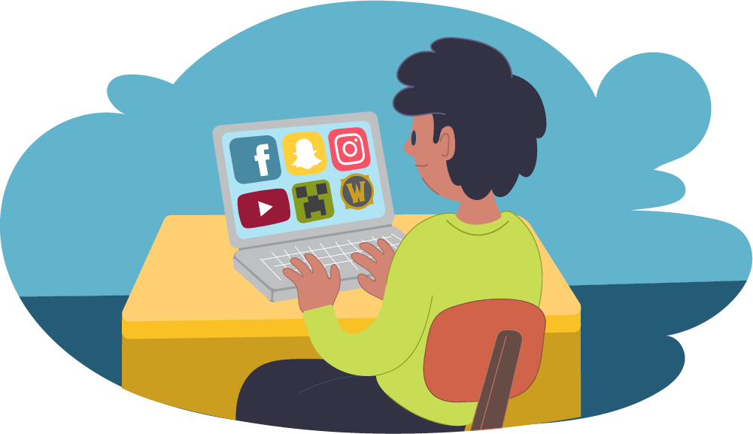
Staying safe online
It’s nice to use phones/the internet to keep in touch, but remember:
Take care with what you post – remember once it’s out there, it’s out there – there’s no taking it back.
Playing computer games online – be aware of who you’re speaking to and what you’re saying.
If anyone says something unkind, upsetting or threatening – block them and tell an adult.
Do not share your details with anyone – this includes your phone number, your address, your passwords, your school etc.
Don’t spend too much time online – it isn’t good for your physical or mental health.

Slide 5
Services that can help you
If you are concerned about something, but it isn’t an emergency where you should dial 999, what could you do?
If you or a friend is in danger from adults or one another you can call Surrey children’s services – 01483 517898 (day time) or Surrey County Councils Safeguarding Hub 0300 470 9100 (Day time)
Non-emergency police – 101(e.g. if something has been stolen, if you have witnessed a crime, you have a concern that isn’t an emergency)
If you want to talk to someone anonymously because you are worried about something or something/one is upsetting you, you can call Childline – 08001111
To contact the school (Ms Mundy) – you can call, text, or WhatsApp on the school mobile _____________. – we will share the number with you in form time.

Slide 6
Safety plans
It might be useful to discuss with an adult at home having a safety
plan in case of emergencies.
What could this include?
Who to contact in an emergency
If the adult in charge suddenly falls ill, who is nearby and could get to you quickly? (Family members, friends, neighbours etc.)
What to do if you feel worried about something (who can you speak to for reassurance or help)
What to do if you feel unwell – plan for if an adult is present and if you are on your own
Think about what you learned yesterday about H&S at home

